Slide 1
LG Boosting

Slide 2
LG Boost
Leaf wise tree growth
Gradient boosting(combine weak models)
Copy data from Different sources
Supports binary, regression and multiclass

Slide 3
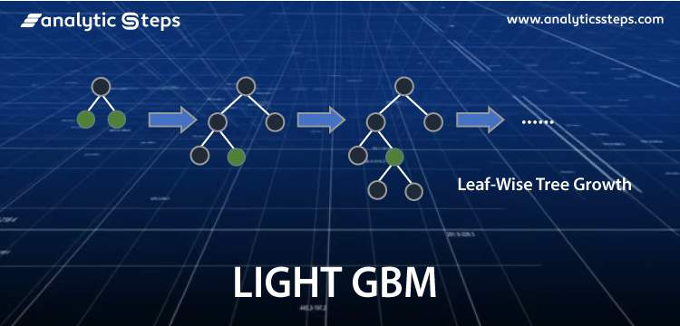
What is LG Boost

Slide 4
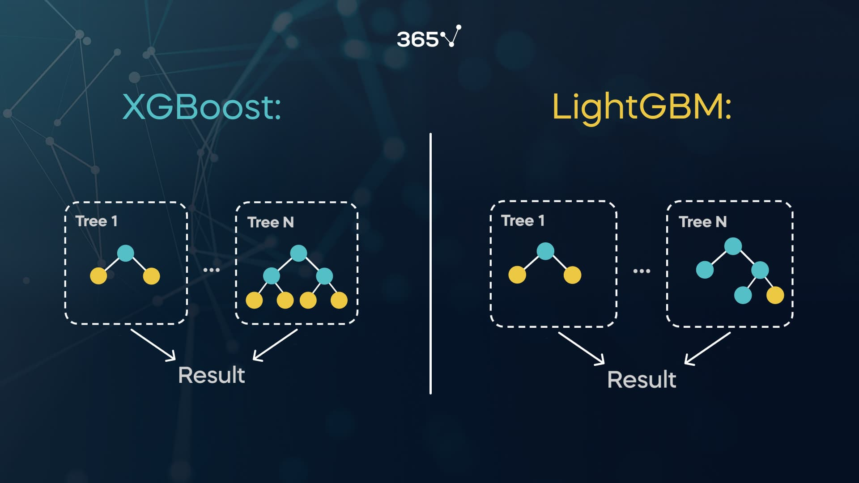
How it works

